Slide 1
Azure Active Driectory for .NET Developers
DOTNETMASTERY

Slide 2
1
INTRODUCTION
DOTNETMASTERY

Slide 3
2
AZURE AD – WEB APPLICATION
DOTNETMASTERY

Slide 4
3
AZURE AD – API
DOTNETMASTERY

Slide 5
4
AZURE AD B2C – WEB APPLICATION
DOTNETMASTERY

Slide 6
5
AZURE AD B2C - ROLES
DOTNETMASTERY

Slide 7
6
AZURE AD B2C - API
DOTNETMASTERY

Slide 8
What this course is not about?
DOTNETMASTERY

Slide 9
PREREQUISITES
DOTNETMASTERY

Slide 10
Azure AD is Microsoft's
cloud-based identity and
access management service

Slide 11


Presentation Layer
Business Layer
Data Access Layer
Legacy
Modern

Slide 12


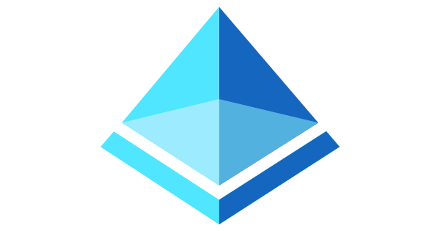
Users, Devices and Application
Global Scale and Availability
Secure and resilient

Slide 13

Active Directory
Active Directory B2C

Slide 14



Full UI Customization
Integrate 3rd party identity providers

